Slide 1
Bluetooth Signal Generator
EE 537 – Fall 2024
- Team Project -
Team Four
Daouda Sane, Jonathan Myers
School of Engineering
University of Alabama at Birmingham

Slide 2
Table of contents
Introduction
Overview, Brainstorm, and Design Options
Design Details
Design Problems and Solutions
Project Labor Division
Suggestions for Future Improvements
References

Slide 3
Introduction
Sané, Daouda
Myers, Jonathan
Problem Summary
Constraints
Use a discrete DAC to design, implement, and test a customizable signal generator that has wireless communication capability, user I/O, and utilizes a file read/write system.
Overall cost for the device must not exceed $100.
Arduino and its clones should be used.
Operating voltage should not exceed 15 Volts for device protection.
Must include and interface with an LCD display, Bluetooth, and an SD card module.
Must utilize an interrupt function

Slide 4
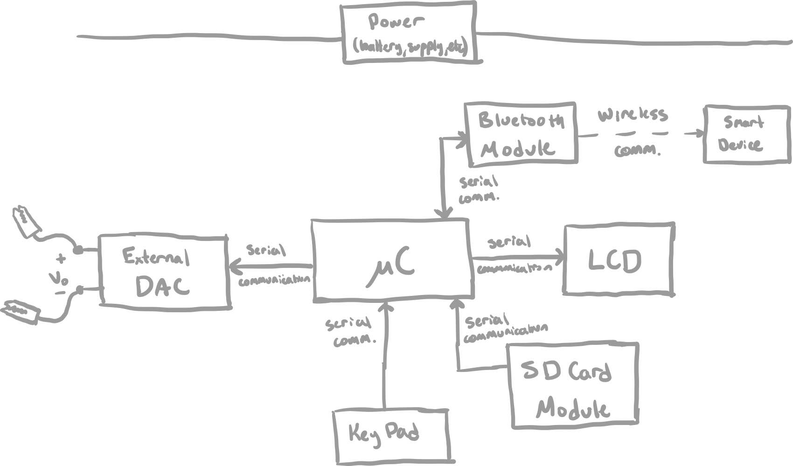
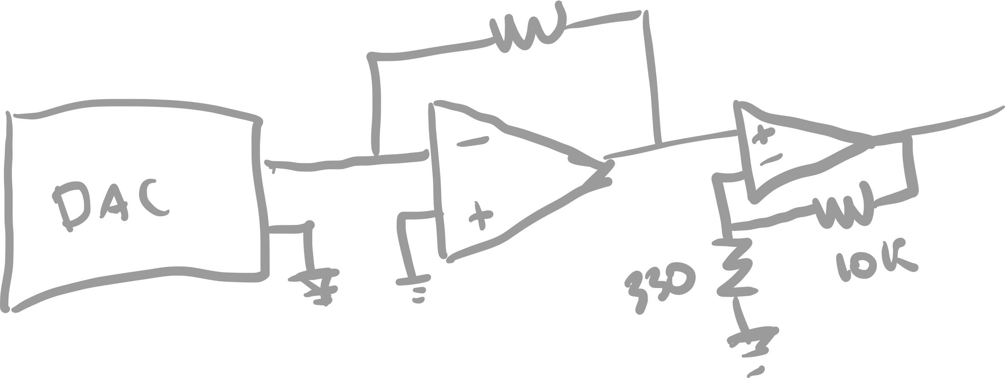
Overview – Initial Brainstorming
Sané, Daouda
Myers, Jonathan
The initial brainstorm session consisted of exploring components’ capabilities, interfacing, as well as developing block diagrams and initial circuit models.
Initial Hand Sketch of Output Amplification Circuit
Initial Block Diagram Sketch

Slide 5
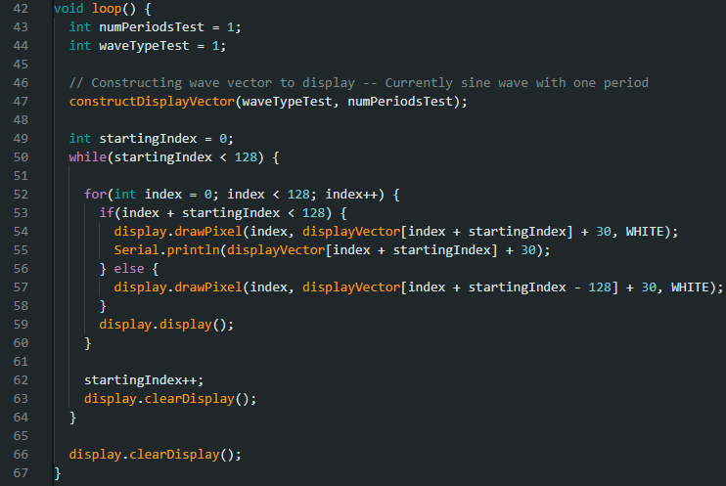
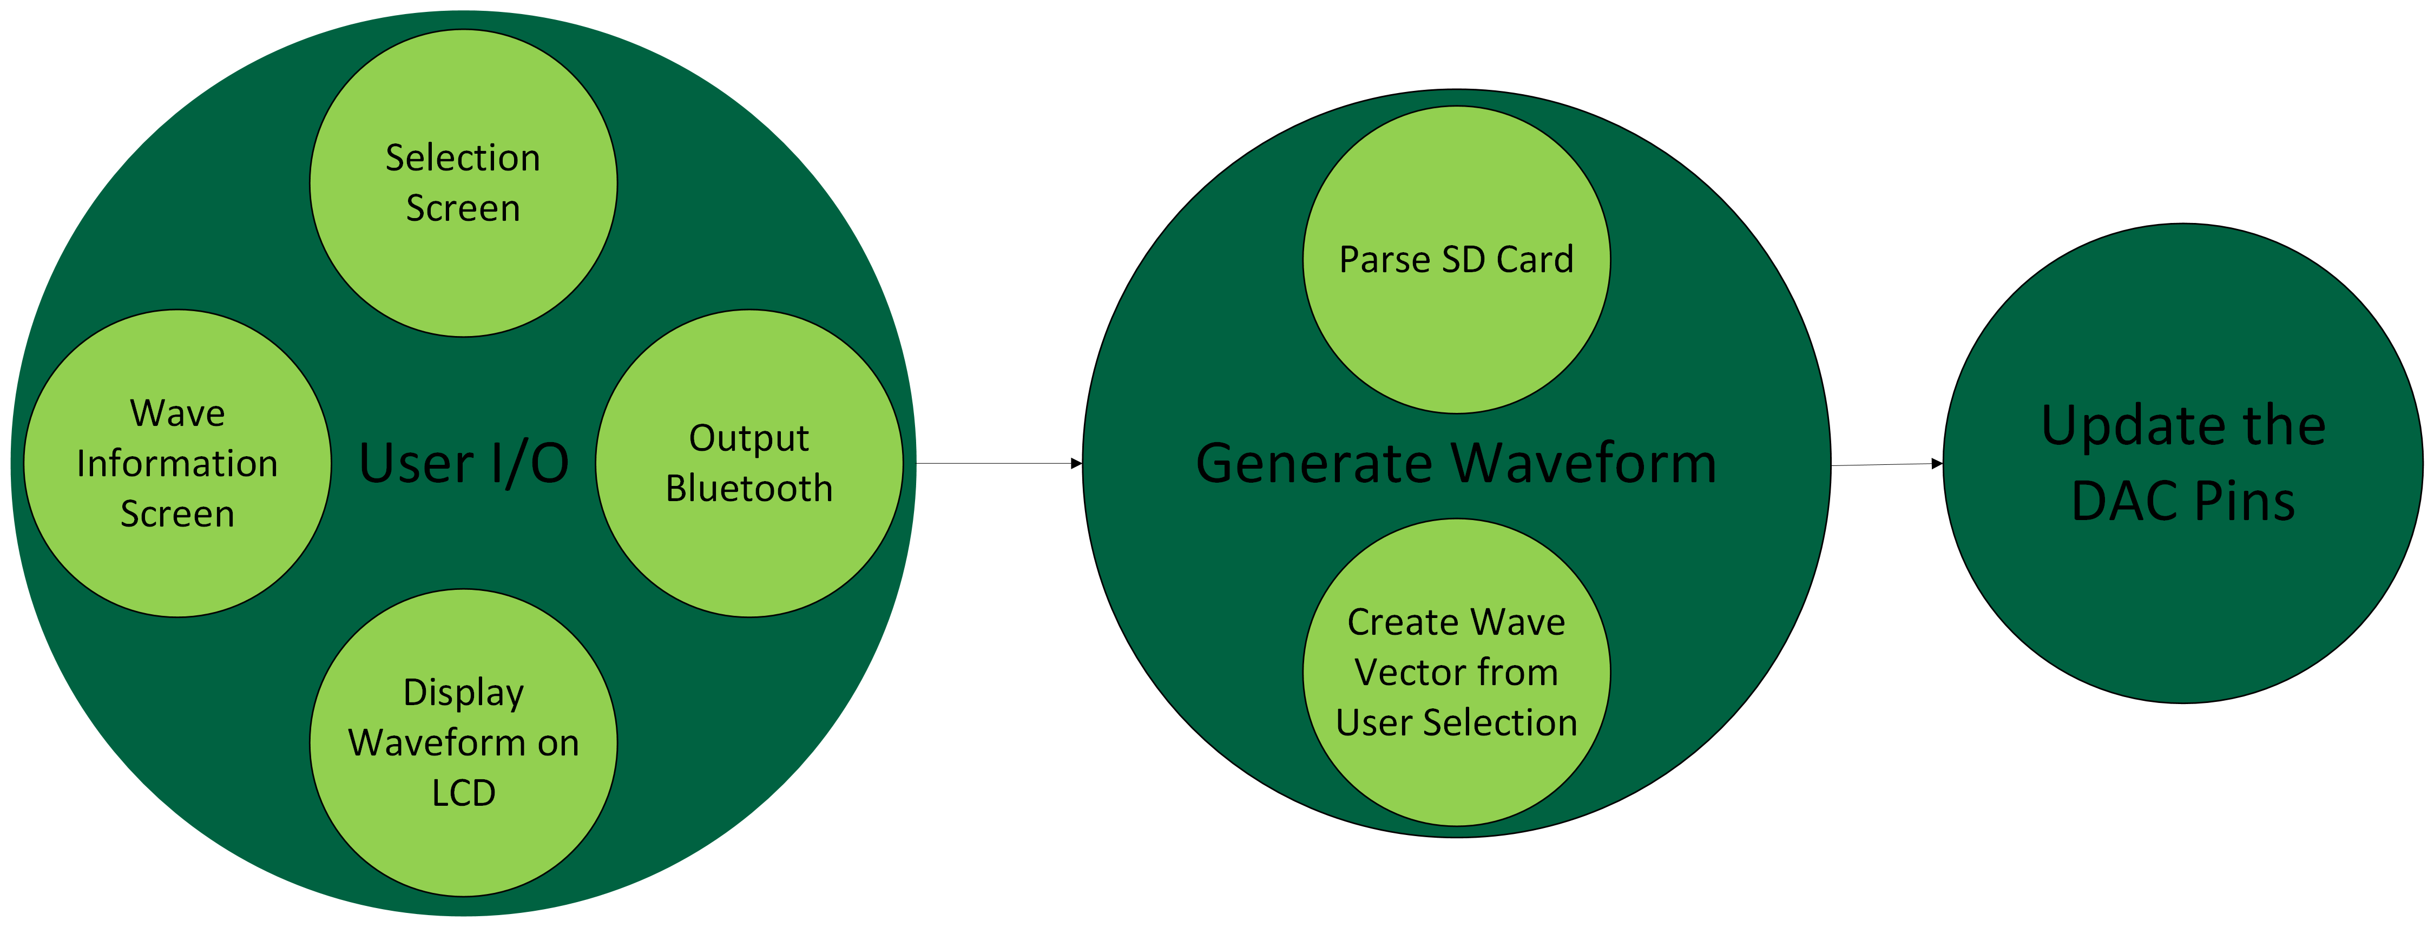
Overview – Component Testing
Sané, Daouda
Myers, Jonathan
Once components were understood, introductory code was developed to test each individual component separately prior to integrating the whole system together.
Initial Software Summary
Example test code for LCD Display
Notes:
Example code:
Test for the LCD display
Showing that I can draw a wave on the display
Initial Software Summary:
Shows main three software blocks
Associated abstracted functions are in the main blocks

Slide 6
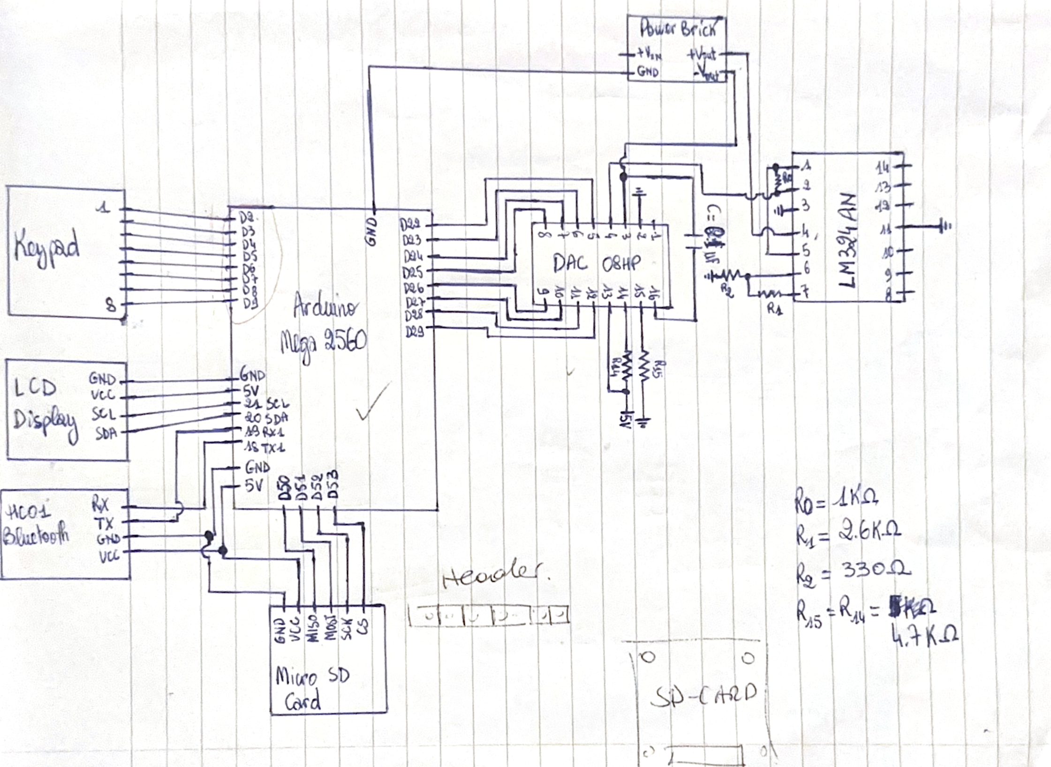
Final Design – Hardware
Sané, Daouda
Myers, Jonathan
Wiring Diagram

Slide 7
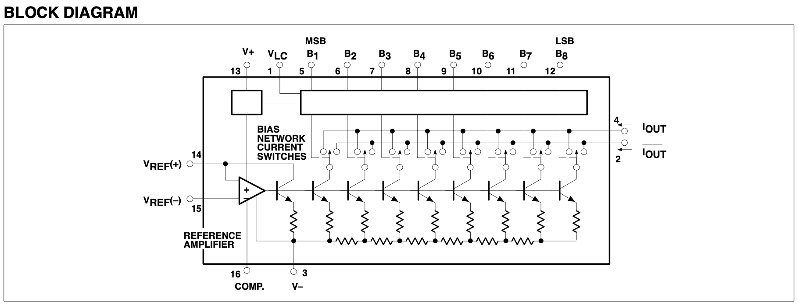
Final Design – Hardware
Sané, Daouda
Myers, Jonathan
DAC 08HP Block Diagram

Slide 8
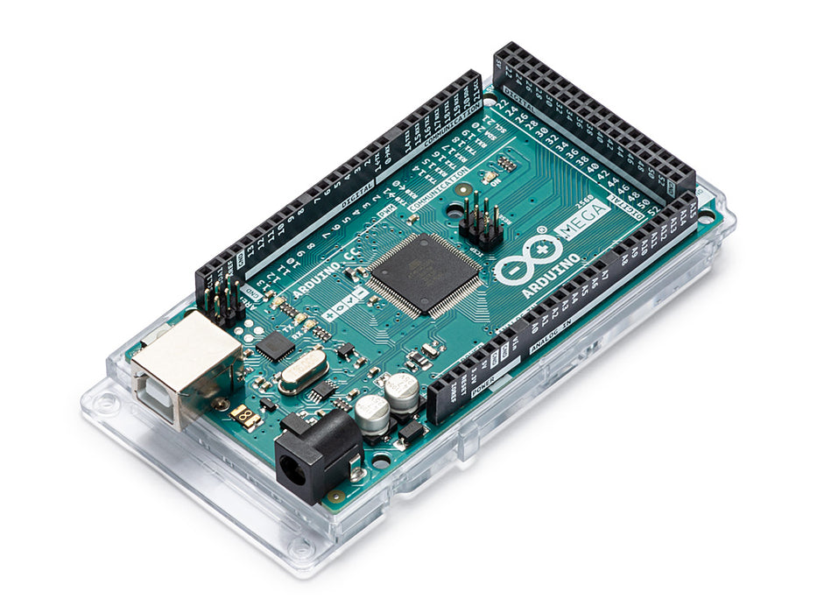
Final Design – Hardware
Sané, Daouda
Myers, Jonathan
Arduino MEGA

Slide 9
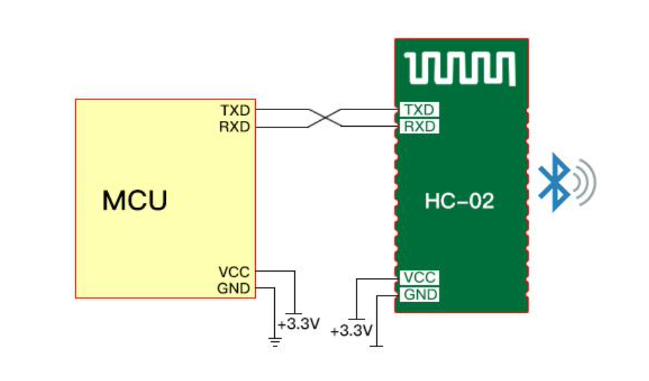
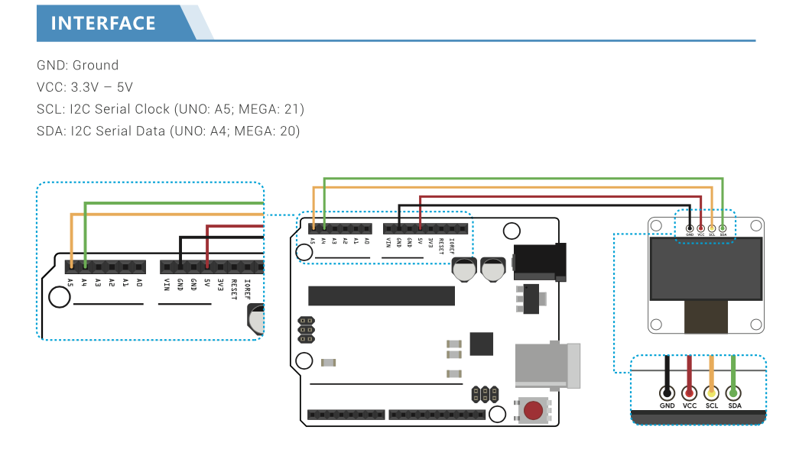
Final Design – Hardware
Sané, Daouda
Myers, Jonathan
Bluetooth
LCD Display

Slide 10
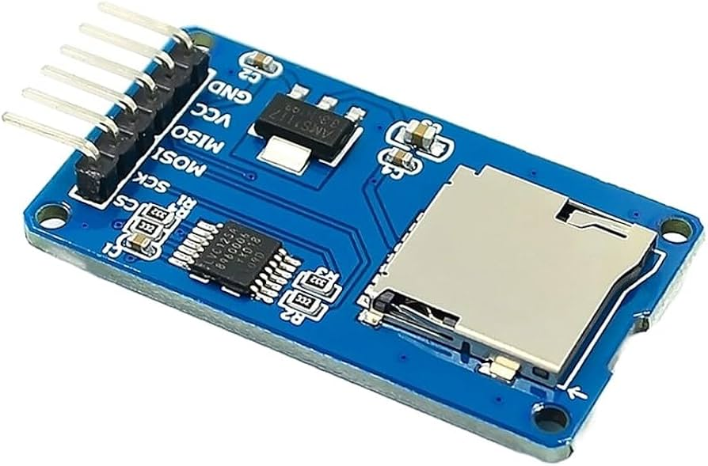
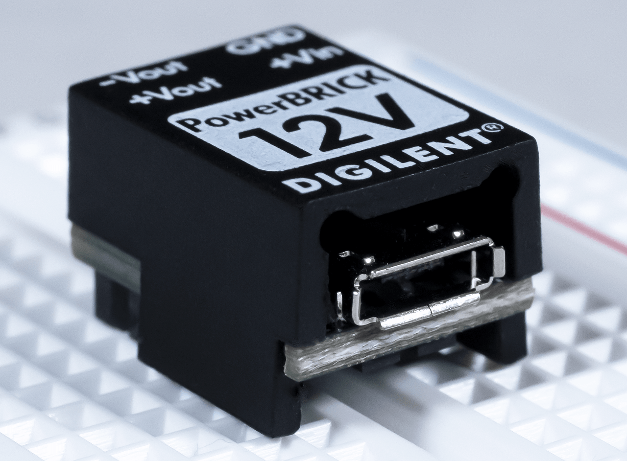
Final Design – Hardware
Sané, Daouda
Myers, Jonathan
Micro SD Card Adapter
Power Specs

Slide 11
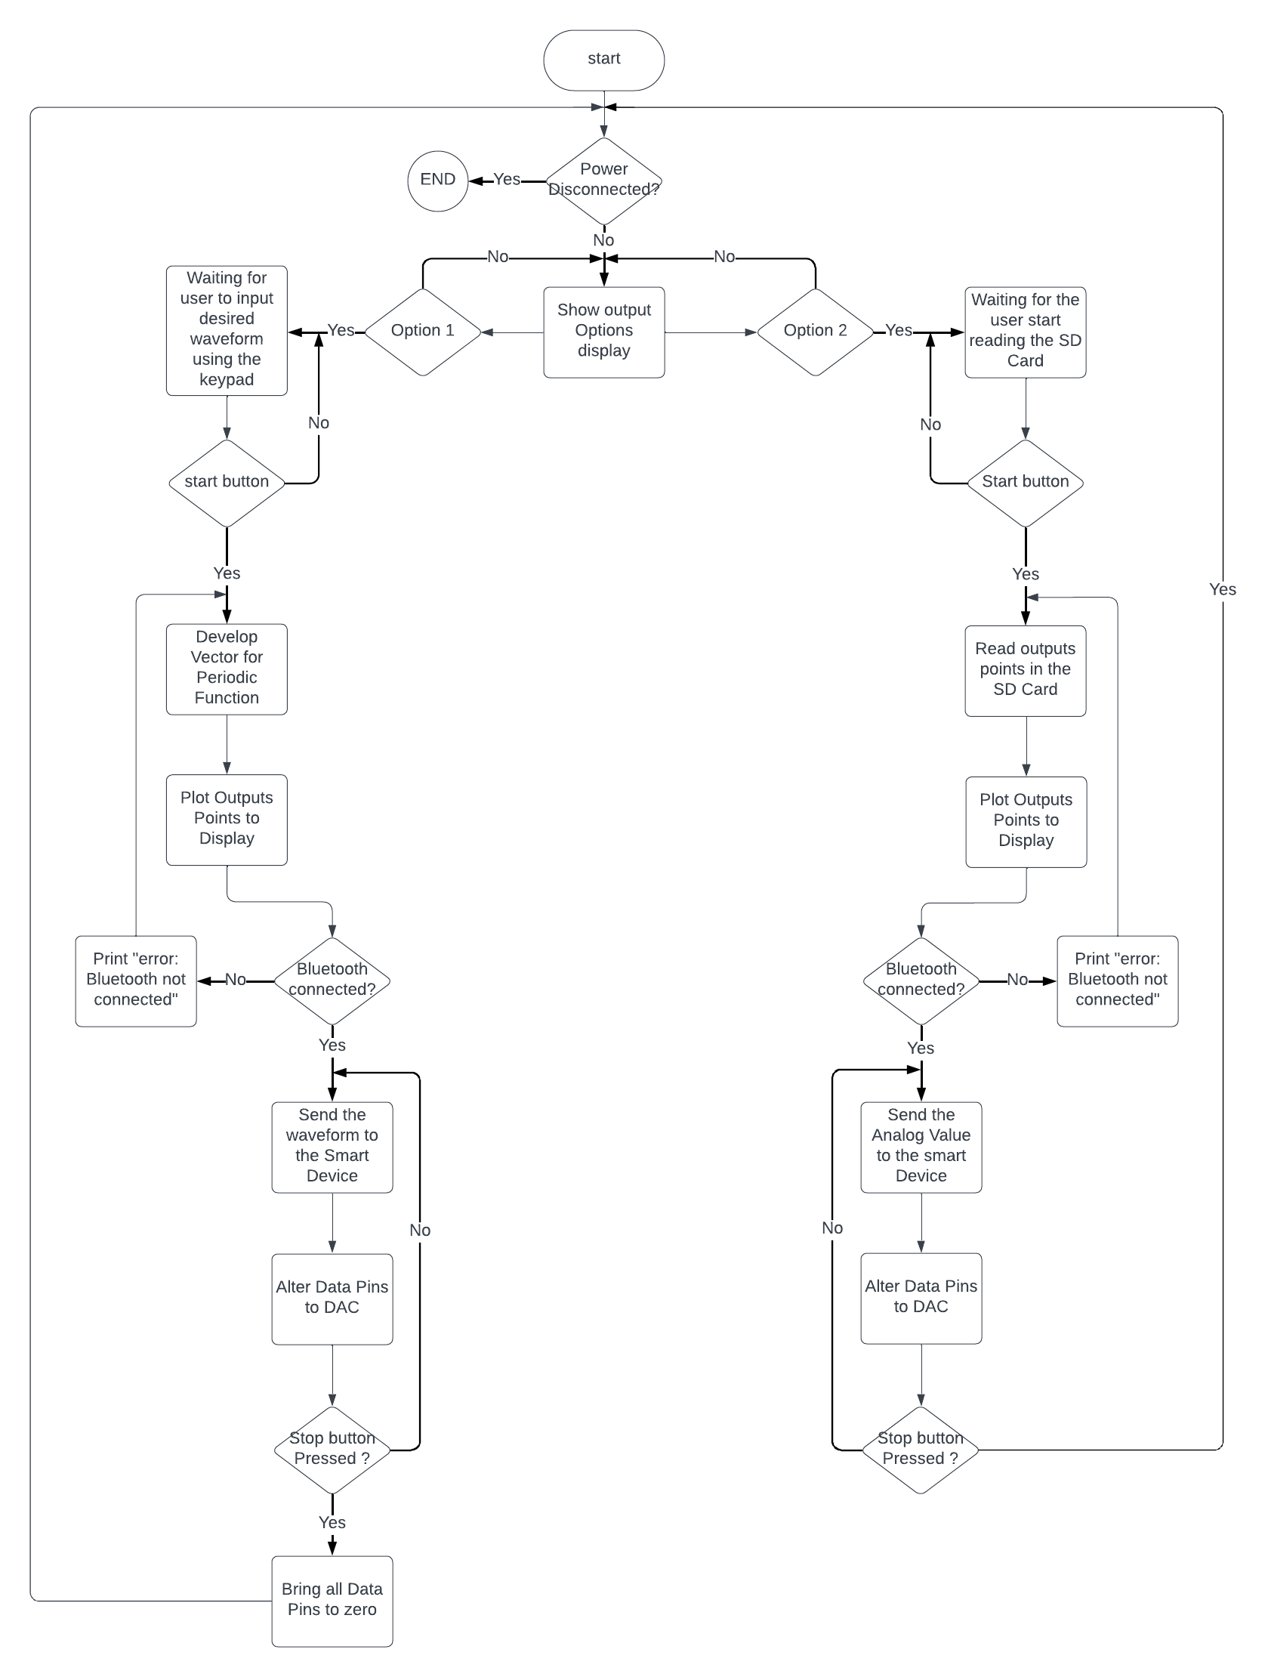
Final Design – Software
Software Flowchart and overall explanation
Sané, Daouda
Myers, Jonathan
Software Summary
Software Flowchart

Slide 12
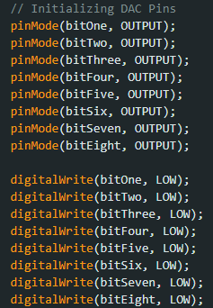
Final Design – Software
Sané, Daouda
Myers, Jonathan
Initialization
All components must be initialized prior to any program functions
This includes:
Bluetooth serial connection
DAC GPIO Pins
Keypad key row/column definitions
SD Card module
LCD Display
DAC GPIO Pins Initialization

Slide 13
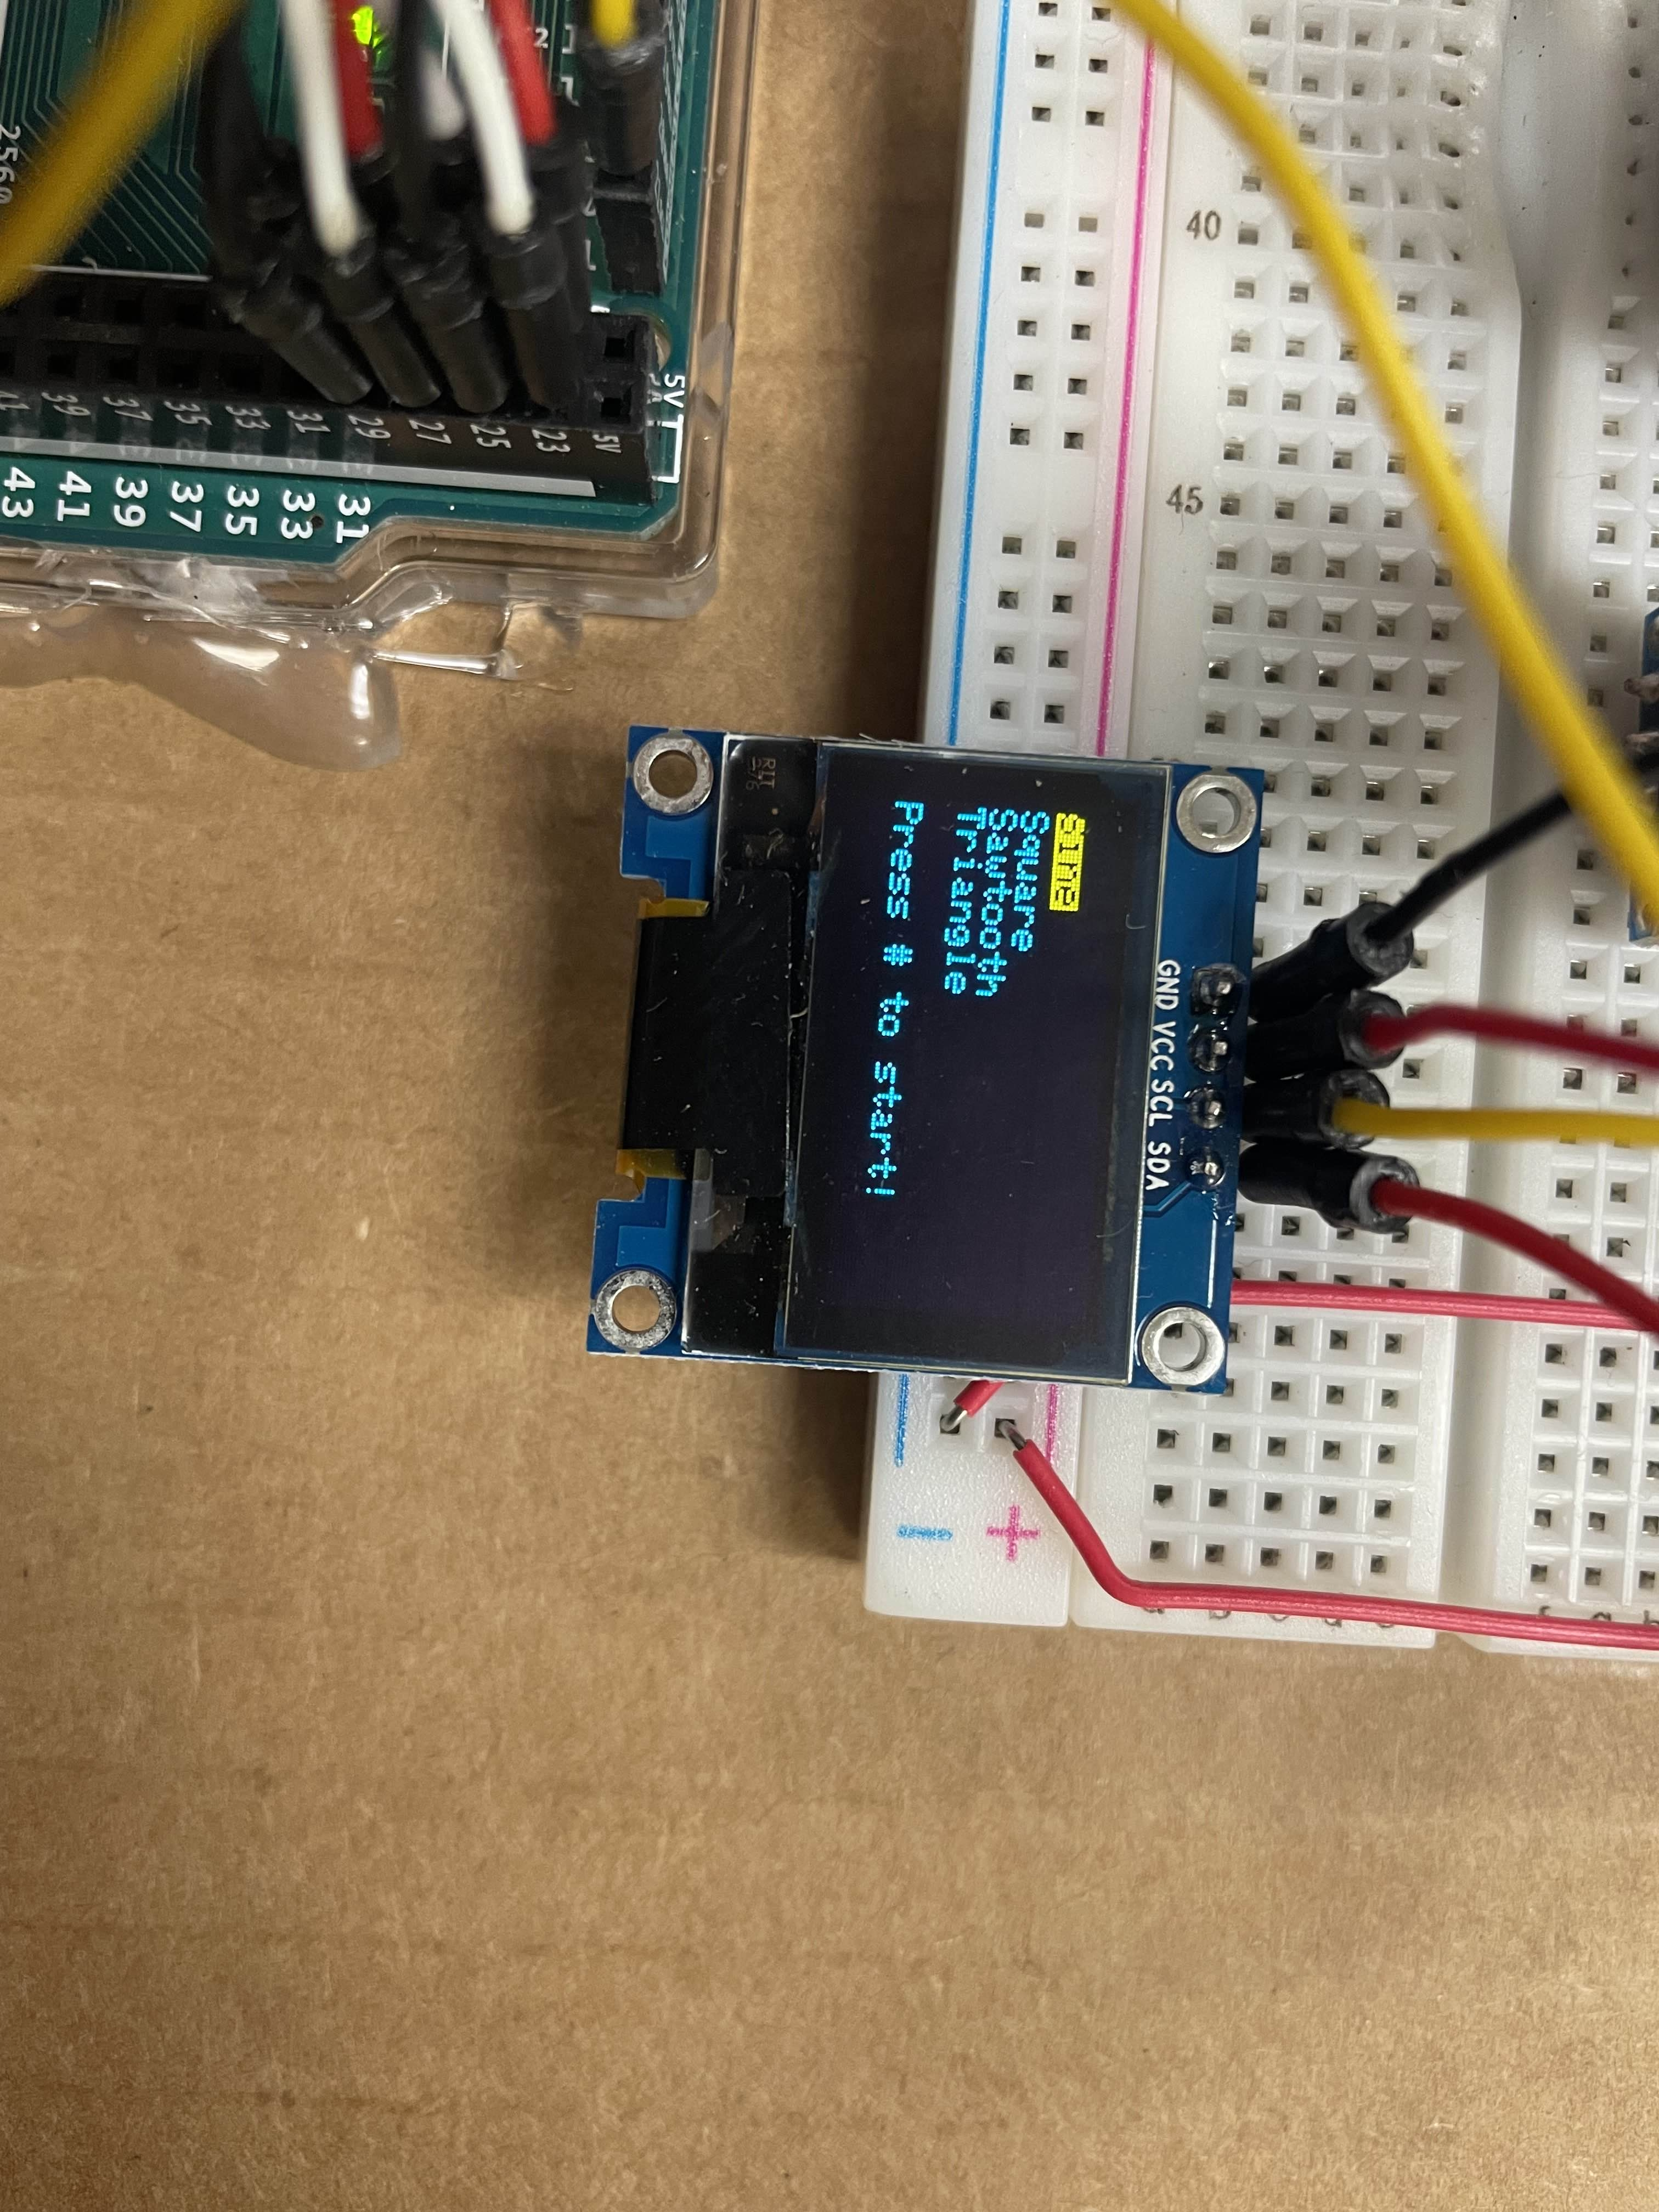
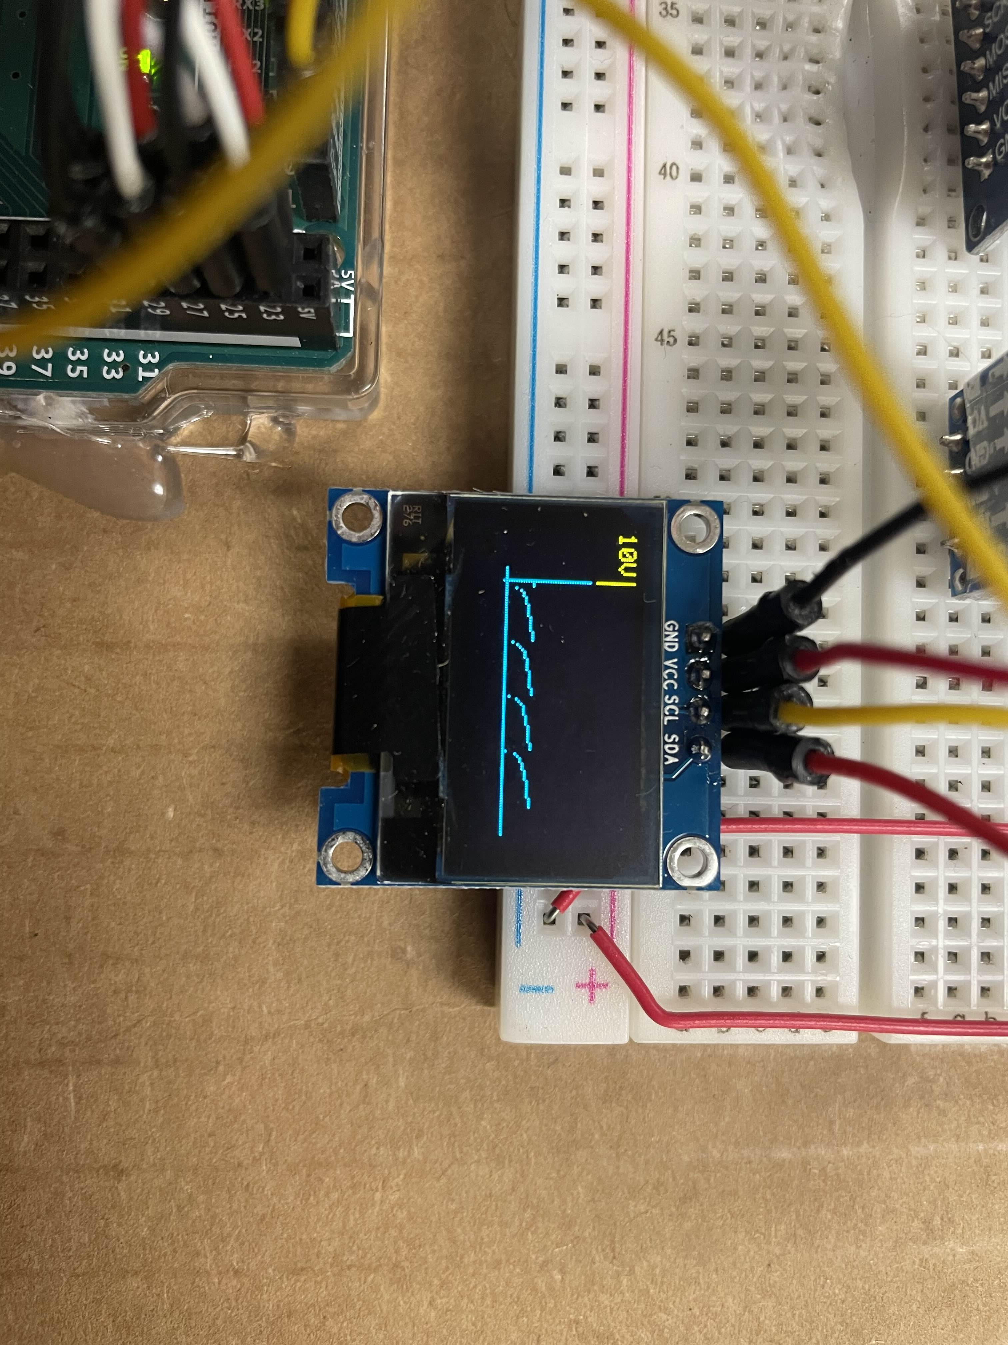
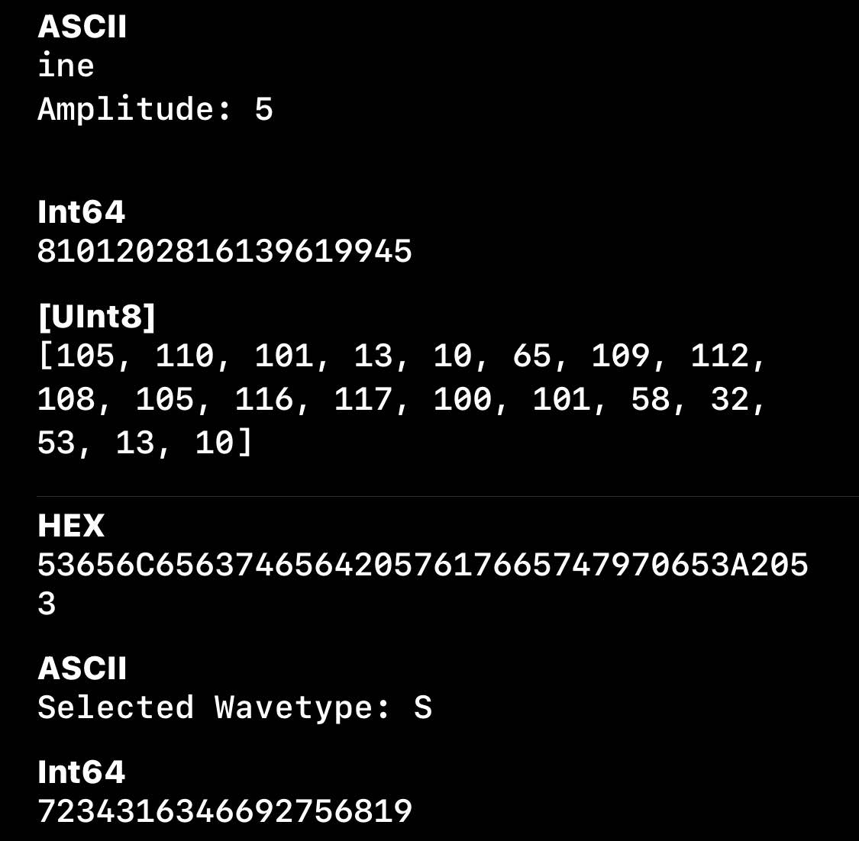
Final Design – Software
Sané, Daouda
Myers, Jonathan
User Input/Output Functions:
fileOrInputScreen()
Prompts user to go to selections screen or import from file
updateSelectionScreen(int, int)
Updates screen based on user input
getWaveformFromFile()
Parses .csv file on SD Card
displayWaveVector()
Displays sample of the output waveform on LCD display
Selection Screen
Waveform from SD Card Displayed
Example Bluetooth Transmission

Slide 14
Final Design – Software
Sané, Daouda
Myers, Jonathan
User-Selected Wave
Wave Imported from SD
Populates global wave vector with calculated values based on user input
Amplitude selection
Wave type selection
Sine
Square
Sawtooth
Triangle
Parses pre-installed .csv file from SD card
Imports list of double values and puts them as elements of the global wave vector

Slide 15
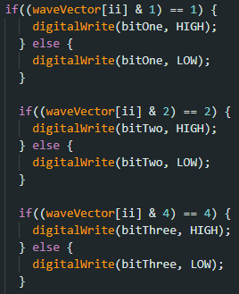
Final Design – Software
Sané, Daouda
Myers, Jonathan
Updating DAC Pins
Done in a timer interrupt to ensure no dropped data
Utilizes an 8-bit int and bit-masking
Sets the GPIO pin associated with the bit to the value of the bit
Repeats this until the “#” key is pressed
Bit Masking Code Example

Slide 16
Design Problems and Solutions
Sané, Daouda
Myers, Jonathan
Problem | Solution
Trouble getting DAC to output physical signal | Introduction of two op amps: One buffer and one gain stage
Inability to connect to Bluetooth module | Set the bluetooth module as Serial1, bypassing any custom libraries
Parsing SD card for this specific application | Implemented a customizable existing library
Utilizing Keypad for starting and stopping wave transmission | Implemented start/stop flags into the software

Slide 17
Labor Division
Sané, Daouda
Myers, Jonathan
Daouda
Jonathan
Experimented and Troubleshot DAC Hardware
Implemented Bluetooth module
Created much of the project documentation
Implemented User I/O
Developed code for DAC, SD Card function, and LCD Display
Tested and troubleshot full system

Slide 18
Future Improvements
Sané, Daouda
Myers, Jonathan
Implement ability to change frequency of signal more easily
Likely will include altering timer prescaler options
Add UI element to support
Clean up data structure in the software
Decrease global variable usage, implement
Make structure of input file more standard
Calibration (with initial waveform + ADC)
Alternative – Gain adjustment knob
Better display, and real-time display updates
Only made possible with higher-performing microcontroller

Slide 19
References
Sané, Daouda
Myers, Jonathan
www.uctronics.com (LCD Display)
Philips Semiconductors Linear Products (DAC08)
www.hc01.com (Bluetooth)
store-usa.arduino.cc (Arduino MEGA)
https://digilent.com (Powerbrick)

Slide 20
Thank you!
Questions?

